Slide 1

Jetpack Compose
Maxim Leykin (maxim.leykin@gmail.com)

Slide 2

What Is Jetpack Compose?
In mathematics, when you take the result of a function f() and feed it to another function g(), you are composing the two functions into a new function h(), whose value is g(f()). You first compute the value of f() and feed its result to g() to get the final result. In Jetpack Compose, we do something similar — you can feed the UI component that one composable generates into another composable to create a more complex UI component. You do this by nesting composables inside other composables.
Jetpack Compose is a UI toolkit that updates the process of building Android apps. Instead of XML, you use Kotlin code to declaratively specify how the UI should look and behave in various states. You don’t have to worry how the UI moves among those states — Jetpack Compose takes care of that.
The Jetpack Compose approach is a significant departure from Android’s original XML UI toolkit, now called Views. In Views, you use a mechanism such as findViewById() or view binding to connect UI elements to code. This imperative approach is simple but requires defining how the program moves among states and how the UI should look and behave in those states.
Jetpack Compose is built with Kotlin, and it takes advantage of the features and design philosophy of Kotlin language. It’s designed for use in applications written in Kotlin. With Jetpack Compose, you no longer have to context-switch to XML when designing your app’s UI; you do everything in Kotlin.

Slide 3
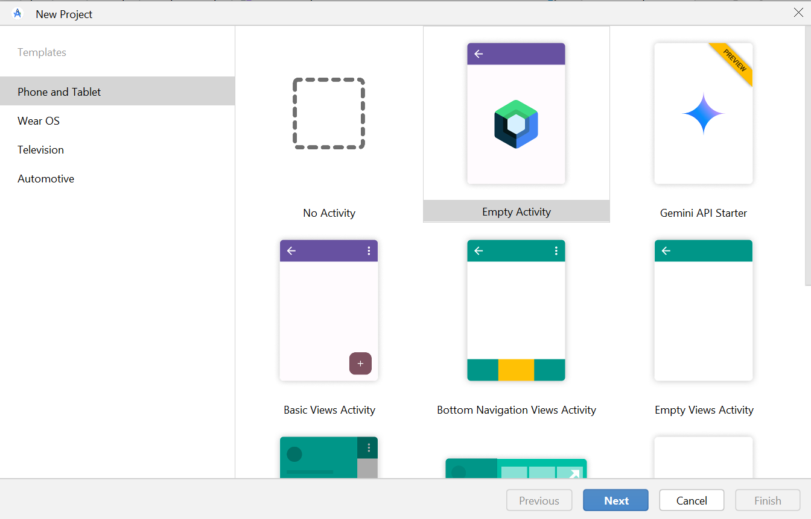
Create Compose project

Slide 4
Hello, Jetpack Compose!
MainActivity.kt still contains a MainActivity class and an onCreate() method. onCreate() still calls on its counterpart in MainActivity’s superclass, ComponentActivity. What’s different is the rest of the code in onCreate().
When building Android UIs the old way — which is now called Views — onCreate() calls the setContentView() method and passes it the ID of the view’s XML file, which Android uses to render the onscreen elements.
In Jetpack Compose, onCreate() calls a method named setContent(). setContent() takes a lambda as its parameter, and inside that lambda is a call to a method called Greeting()
setContent {
ComposeSampleTheme {
// A surface container using the 'background' color from the theme
Surface(
modifier = Modifier.fillMaxSize(),
color = MaterialTheme.colorScheme.background
) {
Greeting("Jetpack Compose")
}
}
}
@Composable
fun Greeting(name: String, modifier: Modifier = Modifier) {
Text(
text = “\n\n\nHello $name!",
modifier = modifier
)
}

Slide 5
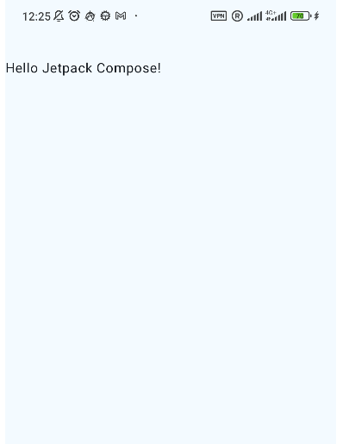
Hello, Jetpack Compose!

Slide 6
Composable functions
The Greeting() function is marked as @Composable. A composable function is a regular function annotated with @Composable. This informs the compiler that Greeting() is a composable function (or composable for short), which means it receives data and generates a UI element in response.
Composable functions:
Can only be called by other composable functions. setContent() which calls Greeting() is a composable.
As a function, it has arguments. That makes composables flexible, allowing you to pass state to them.
It’s a Unit function. It has no return value. Instead, it causes a user interface element to be drawn on screen.
Its name is a CapitalizedNoun. The convention is that composable function names are nouns capitalized in PascalCase. It helps distinguish composables from ordinary functions and methods, where the convention is to make their names verbs that use camelCase capitalization.
It contains a call to a method called Text(). Text() is one of Jetpack Compose’s built-in composables, and given a string, it emits a text view containing that string.

Slide 7

Tweaking the UI
Setting a different background color for the Greeting:
@Composable
fun Greeting(name: String, modifier: Modifier = Modifier) {
Surface(color = MaterialTheme.colorScheme.primary) {
Text(
text = "Hello $name!",
modifier = modifier
)
}
}
?
The text is now white. When did we define this? We didn't! The Material components, such as Surface, are built to make your experience better by taking care of common features that you probably want in your app, such as choosing an appropriate color for text. We say Material is opinionated because it provides good defaults and patterns that are common to most apps. In this case, Surface understands that, when the background is set to the primary color, any text on top of it should use the onPrimary color, which is also defined in the theme.

Slide 8
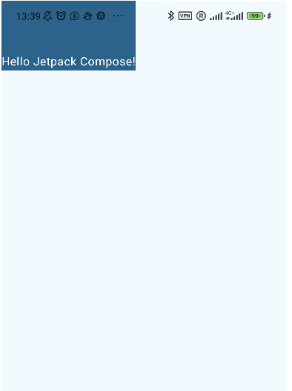
Tweaking the UI
If the parent of your Composable is a Surface, it will try to fill the entire space with the first Composable it finds. To remove this behavior, you need to wrap you Composable in a Box:
setContent {
ComposeSampleTheme {
// A surface container using the 'background' color from the theme
Surface(
modifier = Modifier.fillMaxSize(),
color = MaterialTheme.colorScheme.background
) {
Box {
Greeting("Jetpack Compose")
}
}
}
}

Slide 9

Tweaking the UI
Let’s change font color and paddings:
@Composable
fun Greeting(name: String, modifier: Modifier = Modifier) {
Surface (color = MaterialTheme.colorScheme.primary) {
Text(
text = "Hello $name!",
modifier = Modifier
.padding(36.dp),
color = Color.Red
)
}
}

Slide 10
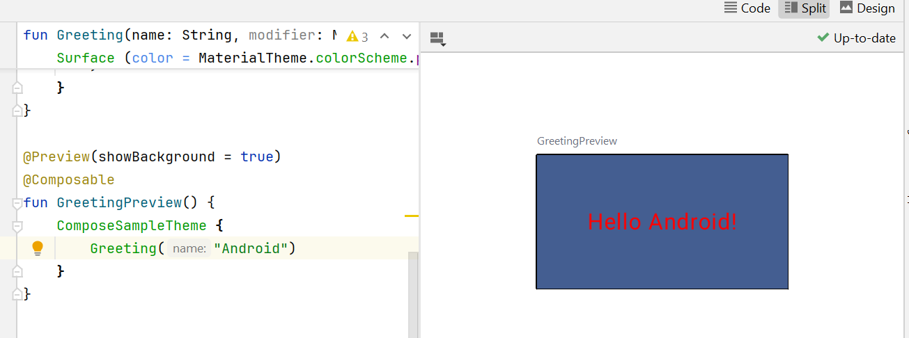
Previewing Composables
As implied by both method name and its @Preview annotation, its purpose is to generate a preview of the output of Greeting() in the preview pane. The @Preview annotation tells the compiler that this composable creates a UI element or container that doesn’t appear in the running app, but instead is rendered in Android Studio’s preview pane. Android Studio watches the code in @Preview composables and updates the Preview pane.
@Preview(showBackground = true)
@Composable
fun GreetingPreview() {
ComposeSampleTheme {
Greeting("Android")
}
}

Slide 11
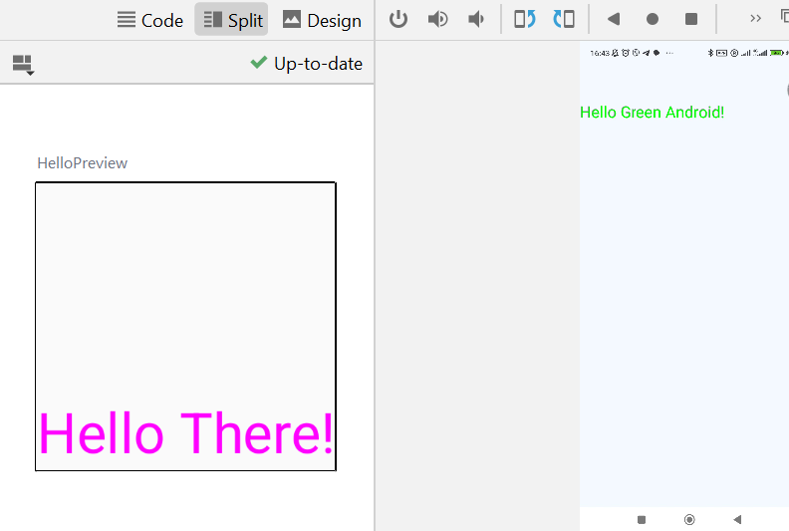
Custom Composable Functions
@Composable
fun Hello(name: String, modifier: Modifier = Modifier, color: Color = Color.Black) {
Text(
text = "Hello $name!",
modifier = modifier,
color = color,
style = MaterialTheme.typography.headlineMedium
)
}
@Preview(showBackground = true)
@Composable
fun HelloPreview() {
ComposeSampleTheme {
Hello(
name = "There",
color = Color.Magenta
)
}
}

Slide 12
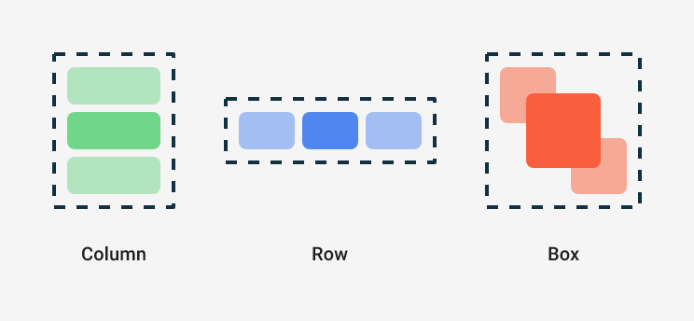
Creating Columns and Rows
Jetpack Compose provides a collection of layout composables — composable functions that emit UI elements that act as containers for laying out other UI elements. Among such composables there are three basic standard layout elements: Column, Row and Box. They are Composable functions that take Composable content and act like a LinearLayout with its orientation parameter set to horizontal or vertical.

Slide 13
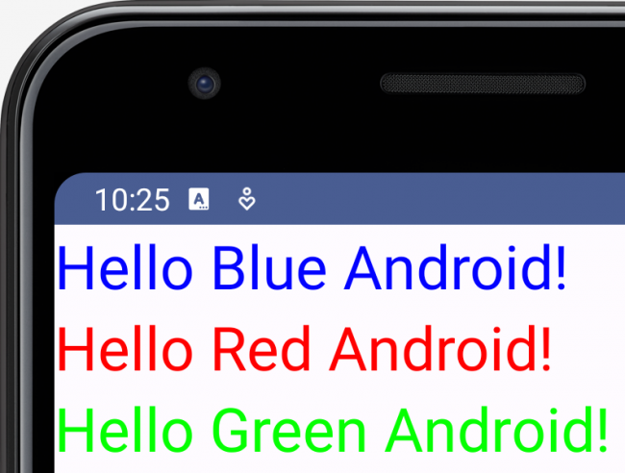
Laying Out Composables
Column {
Hello(
name = "Blue Android",
color = Color.Blue
)
Hello(
name = "Red Android",
color = Color.Red
)
Hello(
name = "Green Android",
color = Color.Green
)
}

Slide 14
Reusing Composables
Making small reusable components increases readability and improves structure, also it's easy to build up a library of UI elements used in your app. Each one is responsible for one small part of the screen and can be edited independently.
Reusable function should include a Modifier parameter that is assigned an empty Modifier by default. Forward this modifier to the first composable which is called inside the function. So, calling site can adapt layout instructions and behaviors from outside of composable function.
class MainActivity : ComponentActivity() {
override fun onCreate(savedInstanceState: Bundle?) {
super.onCreate(savedInstanceState)
setContent {
BasicsCodelabTheme {
MyApp(modifier = Modifier.fillMaxSize())
}
}
}
}
@Preview(showBackground = true)
@Composable
fun GreetingPreview() {
BasicsCodelabTheme {
MyApp()
}
}
@Composable
fun MyApp(modifier: Modifier = Modifier) {
Surface(
modifier = modifier,
color = MaterialTheme.colorScheme.background
) {
Greeting("Android")
}
}

Slide 15
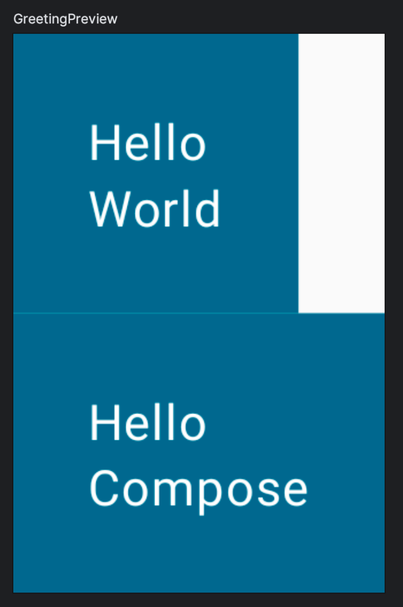
Compose and Kotlin
Composable functions can be used like any other function in Kotlin. This makes building UIs really powerful since you can add statements to influence how the UI will be displayed.
For example, you can use a for loop to add elements to the Column:
@Composable
fun MyApp(
modifier: Modifier = Modifier,
names: List<String> = listOf("World", "Compose")
) {
Column(modifier) {
for (name in names) {
Greeting(name = name)
}
}
}

Slide 16
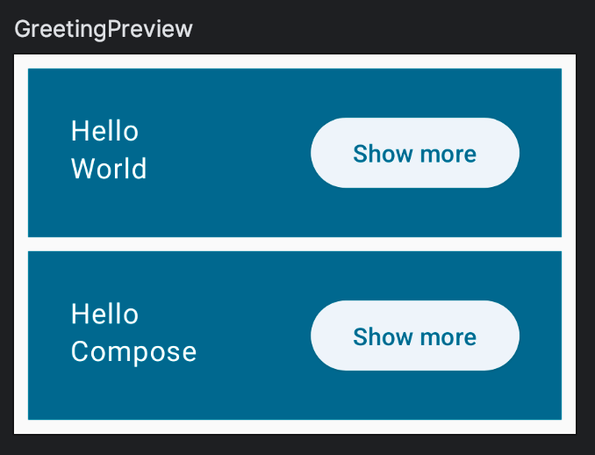
Adding Buttons
// Don't copy yet
Button(
onClick = { } // You'll learn about this callback later
) {
Text("Show more")
}

Slide 17
State in Compose
In an imperative UI model, to change a widget, you call a setter on the widget to change its internal state. In Compose, you call the composable function again with new data. Doing so causes the function to be recomposed--the widgets emitted by the function are redrawn, if necessary, with new data. The Compose framework can intelligently recompose only the components that changed.
To add internal state to a composable, we can use the mutableStateOf() function, which makes Compose recompose functions that read that State. However we can't just assign mutableStateOf() to a variable inside a composable. Recomposition can happen at any time which would call the composable again, resetting the state to a new mutable state with a value of false. To preserve state across recompositions, remember the mutable state using remember to guard against recomposition, so the state is not reset.
If you call the same composable from different parts of the screen you will create different UI elements, each with its own version of the state. The composable function will automatically be "subscribed" to the state. If the state changes, composables that read these fields will be recomposed to display the updates.
import androidx.compose.runtime.mutableStateOf
import androidx.compose.runtime.remember
// ...
@Composable
fun Greeting(...) {
val expanded = remember { mutableStateOf(false) }
// ...
}

Slide 18
State in Compose
@Composable
fun Greeting(name: String, modifier: Modifier = Modifier) {
val expanded = remember { mutableStateOf(false) }
Surface(
color = MaterialTheme.colorScheme.primary,
modifier = modifier.padding(vertical = 4.dp, horizontal = 8.dp)
) {
Row(modifier = Modifier.padding(24.dp)) {
Column(modifier = Modifier.weight(1f)) {
Text(text = "Hello ")
Text(text = name)
}
ElevatedButton(
onClick = { expanded.value = !expanded.value }
) {
Text(if (expanded.value) "Show less" else "Show more")
}
}
}
}

Slide 19
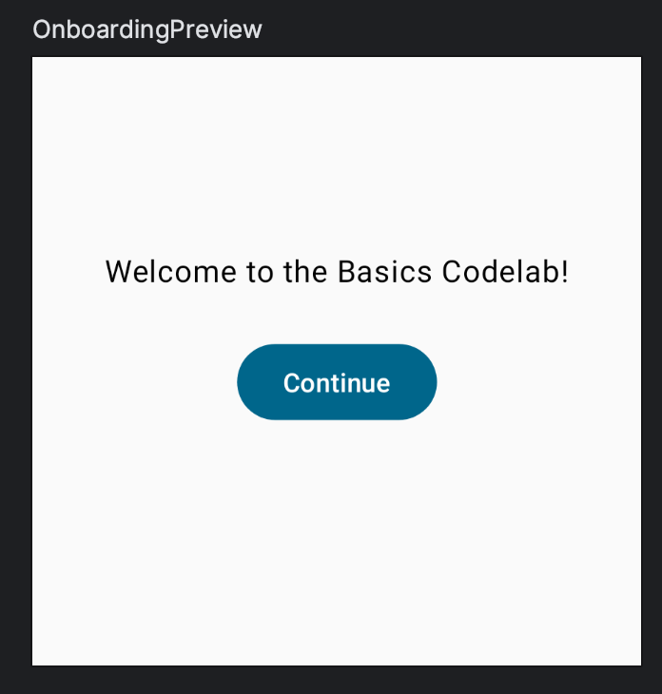
State Hoisting
In Composable functions, state that is read or modified by multiple functions should live in a common ancestor—this process is called state hoisting. To hoist means to lift or elevate.
Making state hoistable avoids duplicating state and introducing bugs, helps reuse composables, and makes composables substantially easier to test. Contrarily, state that doesn't need to be controlled by a composable's parent should not be hoisted. The source of truth belongs to whoever creates and controls that state.
For example, let's create an onboarding screen for our app.

Slide 20
State Hoisting
@Composable
fun OnboardingScreen(modifier: Modifier = Modifier) {
// TODO: This state should be hoisted
var shouldShowOnboarding by remember { mutableStateOf(true) }
Column(
modifier = modifier.fillMaxSize(),
verticalArrangement = Arrangement.Center,
horizontalAlignment = Alignment.CenterHorizontally
) {
Text("Welcome to the Basics Codelab!")
Button(
modifier = Modifier.padding(vertical = 24.dp),
onClick = { shouldShowOnboarding = false }
) {
Text("Continue")
}
}
}
This code contains a bunch of new features:
New composable called OnboardingScreen
Column can be configured to display its contents in the center of the screen
shouldShowOnboarding is using a by keyword instead of the =. This is a property delegate that saves you from typing .value every time.
When the button is clicked, shouldShowOnboarding is set to false, however you are not reading the state from anywhere yet.

Slide 21
State Hoisting
Now we can add this new onboarding screen to our app. We want to show it on launch and then hide it when the user presses "Continue".
In Compose you don't hide UI elements. Instead, you simply don't add them to the composition, so they're not added to the UI tree that Compose generates. You do this with simple conditional Kotlin logic. For example to show the onboarding screen or the list of greetings you would do something like:
// Don't copy yet
@Composable
fun MyApp(modifier: Modifier = Modifier) {
Surface(modifier) {
if (shouldShowOnboarding) {
OnboardingScreen()
} else {
Greetings()
}
}
}

Slide 22
State Hoisting
We don't have access to shouldShowOnboarding . It's clear that we need to share the state that we created in OnboardingScreen with the MyApp composable. Instead of somehow sharing the value of the state with its parent, we hoist the state – move it to the common ancestor that needs to access it. First, move the content of MyApp into a new composable called Greetings.
@Composable
fun MyApp(modifier: Modifier = Modifier) {
Greetings()
}
@Composable
private fun Greetings(
modifier: Modifier = Modifier,
names: List<String> = listOf("World", "Compose")
) {
Column(modifier = modifier.padding(vertical = 4.dp)) {
for (name in names) {
Greeting(name = name)
}
}
}

Slide 23
State Hoisting
Now add the logic to show the different screens in MyApp, and hoist the state. We also need to share shouldShowOnboarding with the onboarding screen but we are not going to pass it directly. Instead of letting OnboardingScreen mutate our state, it would be better to let it notify us when the user clicked on the Continue button.
We pass events by passing callbacks down. Callbacks are functions that are passed as arguments to other functions and get executed when the event occurs.
Try to add a function parameter to the onboarding screen defined as onContinueClicked: () -> Unit so you can mutate the state from MyApp.

Slide 24
State Hoisting
@Composable
fun MyApp(modifier: Modifier = Modifier) {
var shouldShowOnboarding by remember { mutableStateOf(true) }
Surface(modifier) {
if (shouldShowOnboarding) {
OnboardingScreen(onContinueClicked = { shouldShowOnboarding = false })
} else {
Greetings()
}
}
}
@Composable
fun OnboardingScreen(
onContinueClicked: () -> Unit,
modifier: Modifier = Modifier
) {
Column(
modifier = modifier.fillMaxSize(),
verticalArrangement = Arrangement.Center,
horizontalAlignment = Alignment.CenterHorizontally
) {
Text("Welcome to the Basics Codelab!")
Button(
modifier = Modifier
.padding(vertical = 24.dp),
onClick = onContinueClicked
) {
Text("Continue")
}
}
}

Slide 25
State Hoisting

Slide 26
Lazy List
import androidx.compose.foundation.lazy.LazyColumn
import androidx.compose.foundation.lazy.items
// ...
@Composable
private fun Greetings(
modifier: Modifier = Modifier,
names: List<String> = List(1000) { "$it" }
) {
LazyColumn(modifier = modifier.padding(vertical = 4.dp)) {
items(items = names) { name ->
Greeting(name = name)
}
}
}

Slide 27
Persisting State
When rotating the screen, the onboarding screen is shown again. The remember function works only as long as the composable is kept in the Composition. When you rotate, the whole activity is restarted so all state is lost. This also happens with any configuration change and on process death. Instead of using remember you can use rememberSaveable. This will save each state surviving configuration changes (such as rotations) and process death.
import androidx.compose.runtime.saveable.rememberSaveable
// ...
var shouldShowOnboarding by rememberSaveable { mutableStateOf(true) }
If you expand a list item and then either scroll the list until the item is out of view, or rotate the device and then go back to the expanded item, you'll see that the item is now back to its initial state.
The solution for this is to use rememberSaveable for the expanded state as well:
var expanded by rememberSaveable { mutableStateOf(false) }

